Slide 1


Fundamentals of Big Data Unit 1 - LECTURE 6, 7
Dr. Lakshmi J V N
Associate Professor
Jain University

Slide 3
Datasets
tweets stored in a flat file
a collection of image files in a directory
an extract of rows from a database table stored in a CSV formatted file
historical weather observations that are stored as XML files

Slide 4
Data Analysis
Data analysis is the process of examining data to find facts, relationships, patterns, insights and/or trends. The overall goal of data analysis is to support better decision making.

Slide 5
Data Analytics
Data analytics is a broader term that encompasses data analysis. Data analytics is a discipline that includes the management of the complete data lifecycle, which encompasses collecting, cleansing, organizing, storing, analyzing and governing data. The term includes the development of analysis methods, scientific techniques and automated tools. In Big Data environments, data analytics has developed methods that allow data analysis to occur through the use of highly scalable distributed technologies and frameworks that are capable of analyzing large volumes of data from different sources.

Slide 7
Types of Analytics
Data analytics enable data-driven decision-making with scientific backing so that decisions can be based on factual data and not simply on past experience or intuition alone. There are four general categories of analytics that are distinguished by the results they produce:

Slide 8
Prescriptive analytics
Prescriptive analytics build upon the results of predictive analytics by prescribing actions that should be taken. The focus is not only on which prescribed option is best to follow, but why. In other words, prescriptive analytics provide results that can be reasoned about because they embed elements of situational understanding.

Slide 9
Predictive Analytics
Predictive analytics are carried out in an attempt to determine the outcome of an event that might occur in the future. With predictive analytics, information is enhanced with meaning to generate knowledge that conveys how that information is related

Slide 10
Diagnostic Analytics
Diagnostic analytics aim to determine the cause of a phenomenon that occurred in the past
using questions that focus on the reason behind the event.

Slide 11
Descriptive Analytics
Descriptive analytics are carried out to answer questions about events that have already
occurred. This form of analytics contextualizes data to generate information.

Slide 12
Business Intelligence
BI enables an organization to gain insight into the performance of an enterprise by analyzing data generated by its business processes and information systems. The results of the analysis can be used by management to steer the business in an effort to correct detected issues or otherwise enhance organizational performance. BI applies analytics to large amounts of data across the enterprise, which has typically been consolidated into an enterprise data warehouse to run analytical queries.

Slide 13
Key Performance Indicators
A KPI is a metric that can be used to gauge success within a particular business context.
KPIs are linked with an enterprise’s overall strategic goals and objectives. They are often
used to identify business performance problems and demonstrate regulatory compliance.
KPIs therefore act as quantifiable reference points for measuring a specific aspect of a
business’ overall performance.

Slide 14
Features Processing Data by using ETL

Slide 15
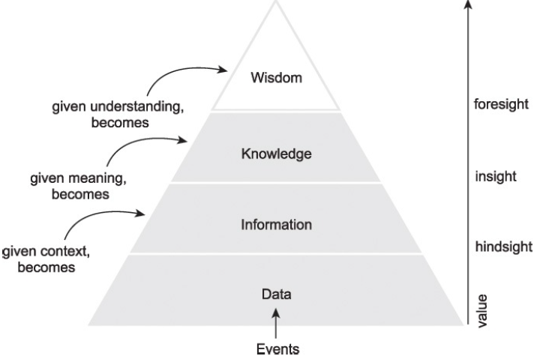
Market Dynamics
The transition from hindsight to foresight can be understood through the lens of the DIKW pyramid depicted in Figure. Note that in this figure, at the top of the triangle, wisdom is shown as an outline to indicate that it exists but is not typically generated via ICT systems. Instead, knowledge workers provide the insight and experience to frame the available knowledge so that it can be integrated to form wisdom.

Slide 16
Business Architecture
Big Data has ties to business architecture at each of the organizational layers, as depicted in Figure. Big Data enhances value as it provides additional context through the integration of external perspectives to help convert data into information and provide meaning to generate knowledge from information. For instance, at the operational level, metrics are generated that simply report on what is happening in the business. In essence, we are converting data through business concepts and context to generate information. At the managerial level, this information can be examined through the lens of corporate performance to answer questions regarding how the business is performing. In other words, give meaning to the information. This information may be further enriched to answer questions regarding why the business is performing at the level it is. When armed with this knowledge, the strategic layer can provide further insight to help answer questions of which strategy needs to change or be adopted in order to correct or enhance the performance.

Slide 18
Data Analytics and Data Science
Enterprises are collecting, procuring, storing, curating and processing increasing quantities of data. This is occurring in an effort to find new insights that can drive more efficient and effective operations, provide management the ability to steer the business proactively and allow the C-suite to better formulate and assess their strategic initiatives. Ultimately, enterprises are looking for new ways to gain a competitive edge. Thus the need for techniques and technologies that can extract meaningful information and insights has increased. Computational approaches, statistical techniques and data warehousing have advanced to the point where they have merged, each bringing their specific techniques and tools that allow the performance of Big Data analysis.

Slide 19
Digitization
For many businesses, digital mediums have replaced physical mediums as the de facto communications and delivery mechanism. The use of digital artifacts saves both time and cost as distribution is supported by the vast pre-existing infrastructure of the Internet. As consumers connect to a business through their interaction with these digital substitutes, it leads to an opportunity to collect further “secondary” data; for example, requesting a customer to provide feedback, complete a survey, or simply providing a hook to display a relevant advertisement and tracking its click-through rate. Collecting secondary data can be important for businesses because mining this data can allow for customized marketing, automated recommendations and the development of optimized product features

Slide 20
Affordable Technology & Commodity Hardware
Technology capable of storing and processing large quantities of diverse data has become increasingly affordable. Additionally, Big Data solutions often leverage open-source software that executes on commodity hardware, further reducing costs. The combination of commodity hardware and open source software has virtually eliminated the advantage that large enterprises used to hold by being able to outspend their smaller competitors due to the larger size of their IT budgets. Technology no longer delivers competitive advantage. Instead, it simply becomes the platform upon which the business executes. From a business standpoint, utilization of affordable technology and commodity hardware to generate analytic results that can further optimize the execution of its business processes is the path to competitive advantage.

Slide 22
Internet of Everything (IoE)
The IoE combines the services provided by smart connected devices of the Internet of Things into meaningful business processes that possess the ability to provide unique and differentiating value propositions. It is a platform for innovation enabling the creation of new products and services and new sources of revenue for businesses. Big Data is the heart of the IoE. Hyper-connected communities and devices running on affordable technology and commodity hardware stream digitized data that is subject to analytic processes hosted in elastic cloud computing environments.

